Slide 1


Slide 2

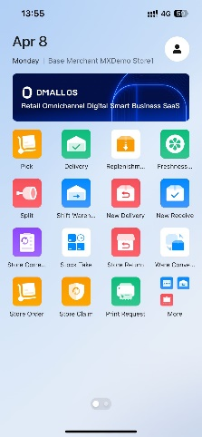
Basic Operation
???
Purchasing - COST
All modules backstage general control system, to achieve the platform data capture at all times, to achieve intelligent decision-making
DMALL OS
Intelligent scheduling of mobile workstations, employees receive tasks in the mobile APP, through real-time data monitoring, with big data computing, store operations at a glance
DMALL OS APP
2

Slide 3
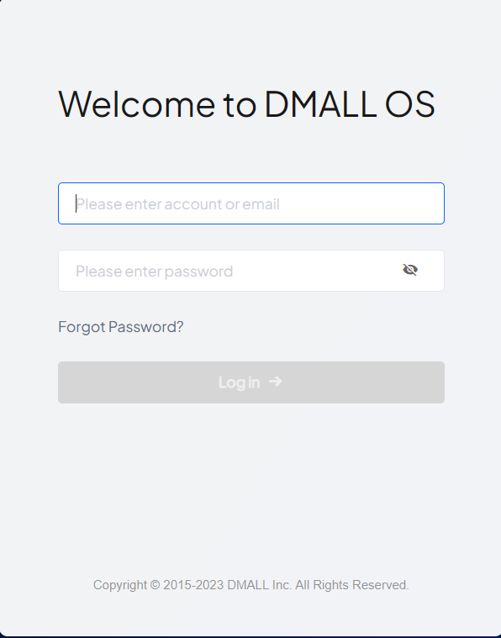
1.DMALL OS（1）
Basic Operation
???
Purchasing - COST
DMALL OS login
Operation steps:
Enter your login and password and click Login
1
3
Notes:
输入登陆账号及密码，点击【登录】

Slide 4
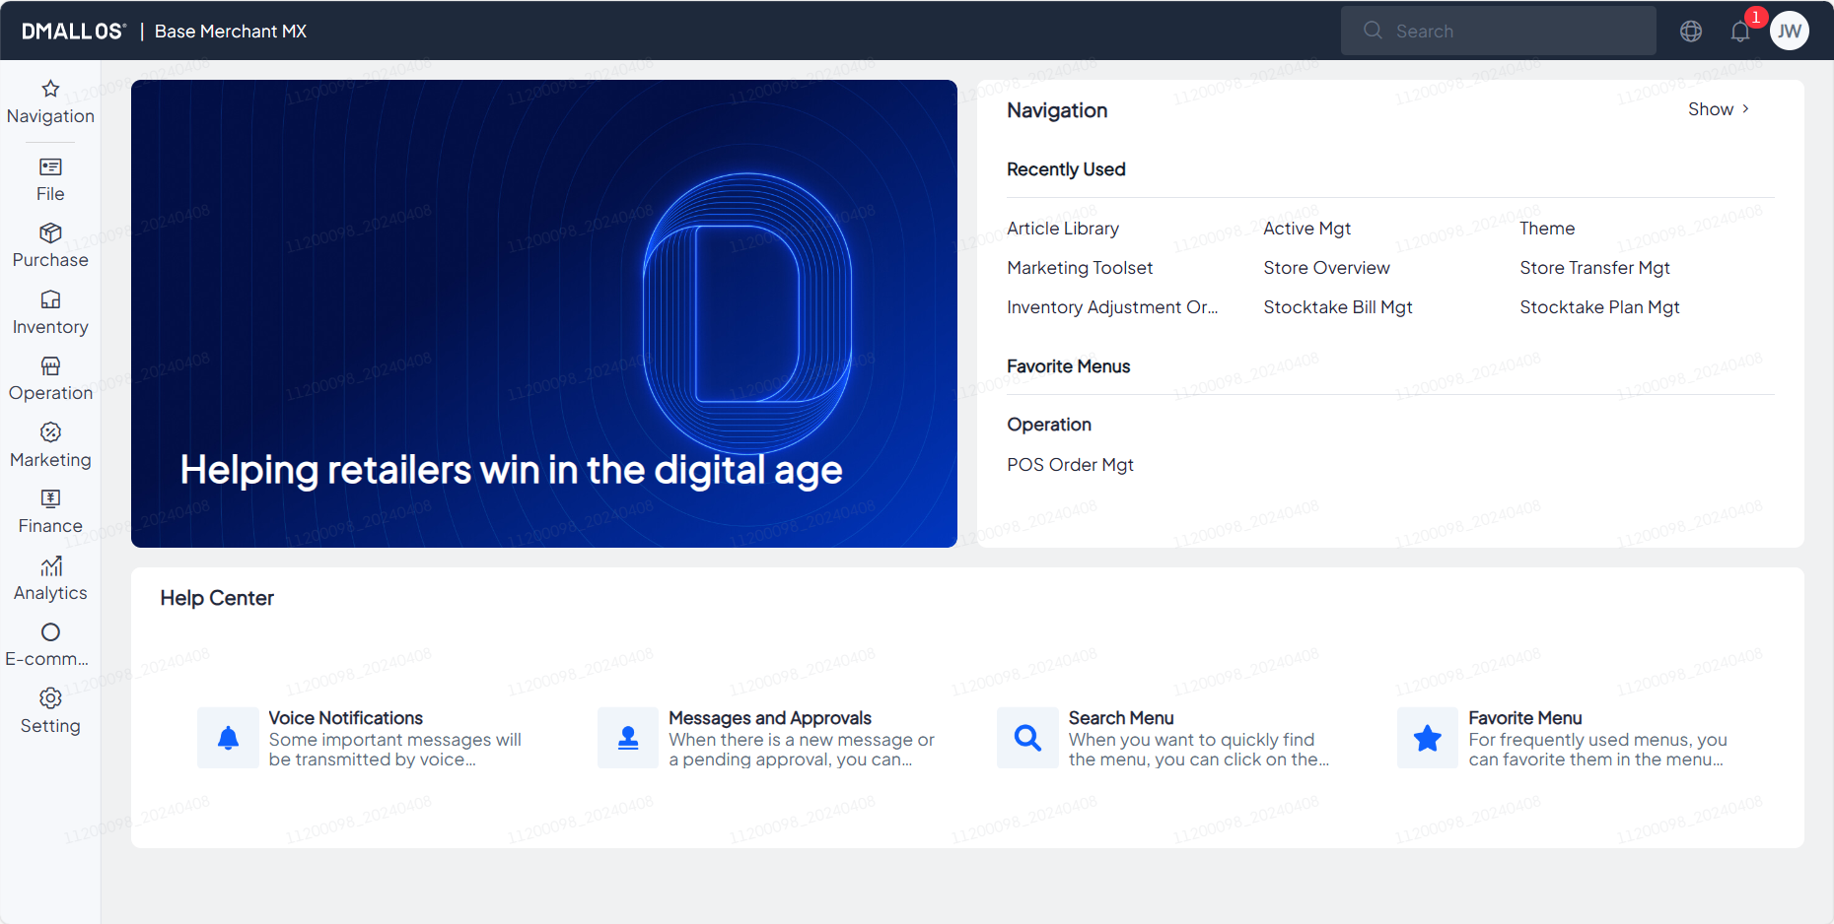
1.DMALL OS（2）
Basic Operation
???
Purchasing - COST
DMALL OS Interface Introduction
Note:
After entering the DMALL OS, you can see the directory on the left side, where you can select the corresponding functional modules
On the top side, you can view tasks, messages, merchant names and other related informations
4

Slide 5
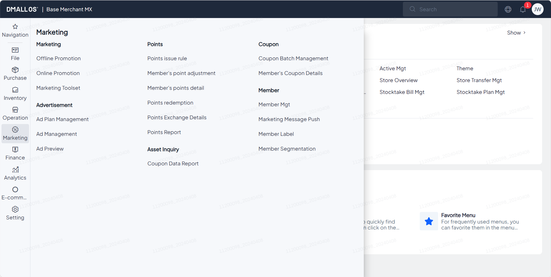
1.DMALL OS（3）
Basic Operation
???
Purchasing - COST
DMALL OS Interface Introduction
Note:
Click on the relevant functional module in the left menu, the corresponding functional content will appear on the right side for relevant operations
5

Slide 6
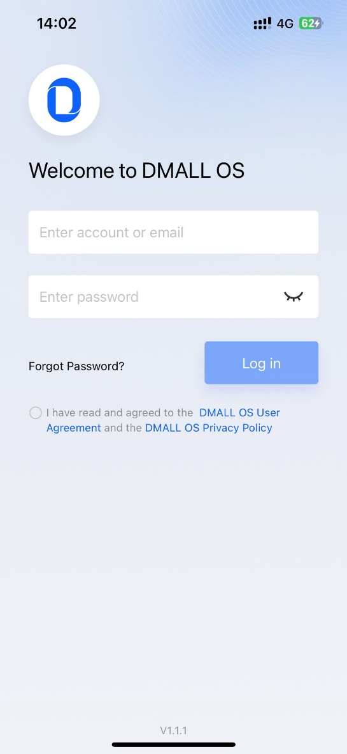
2.DMALL OS APP（1）
Basic Operation
???
Purchasing - COST
DMALL OS APP login
Operation steps:
Agree 《DMALL OS user agreement》《 DMALL OS privacy policy》
Log in
6
Notes:
登陆界面

Slide 7
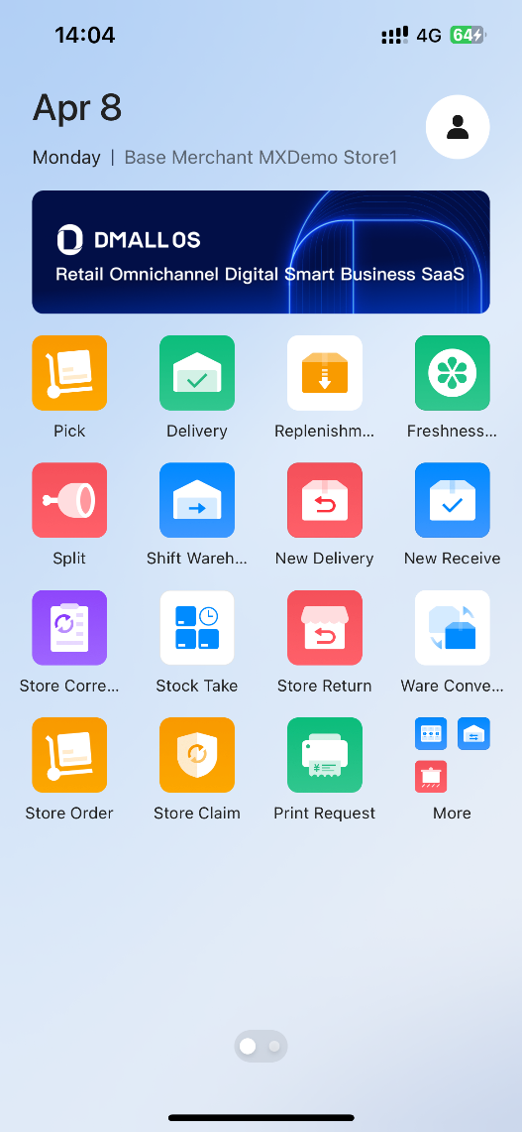
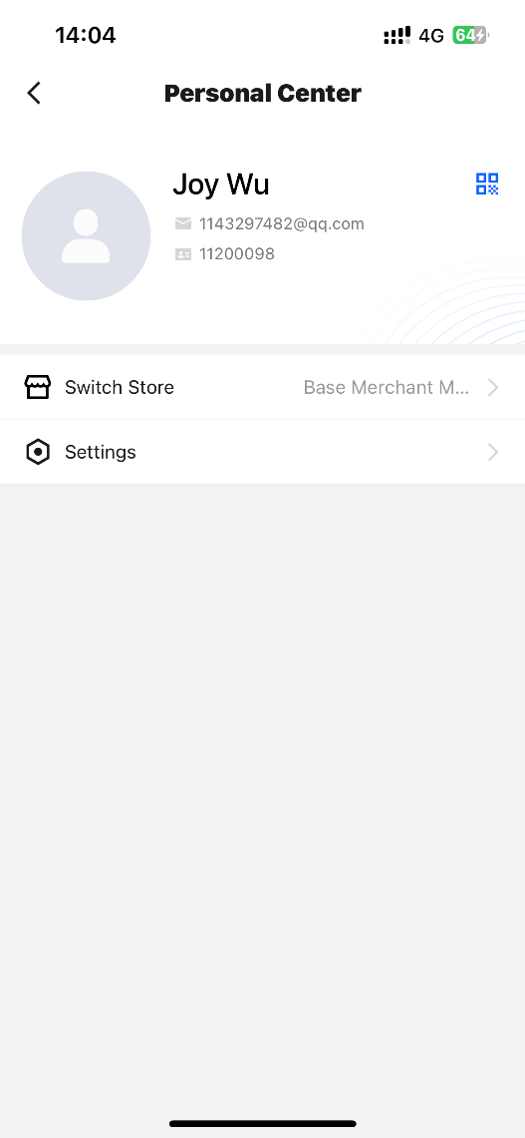
2.DMALL OS APP（2）
Basic Operation
???
Purchasing - COST
Query Employee Code
Operation steps:
Click to in Personal center
Click QR code to view employee code
1
2
Note：
After successful login, enter the home page
7

Slide 8

Thank you for your participation

